Slide 1
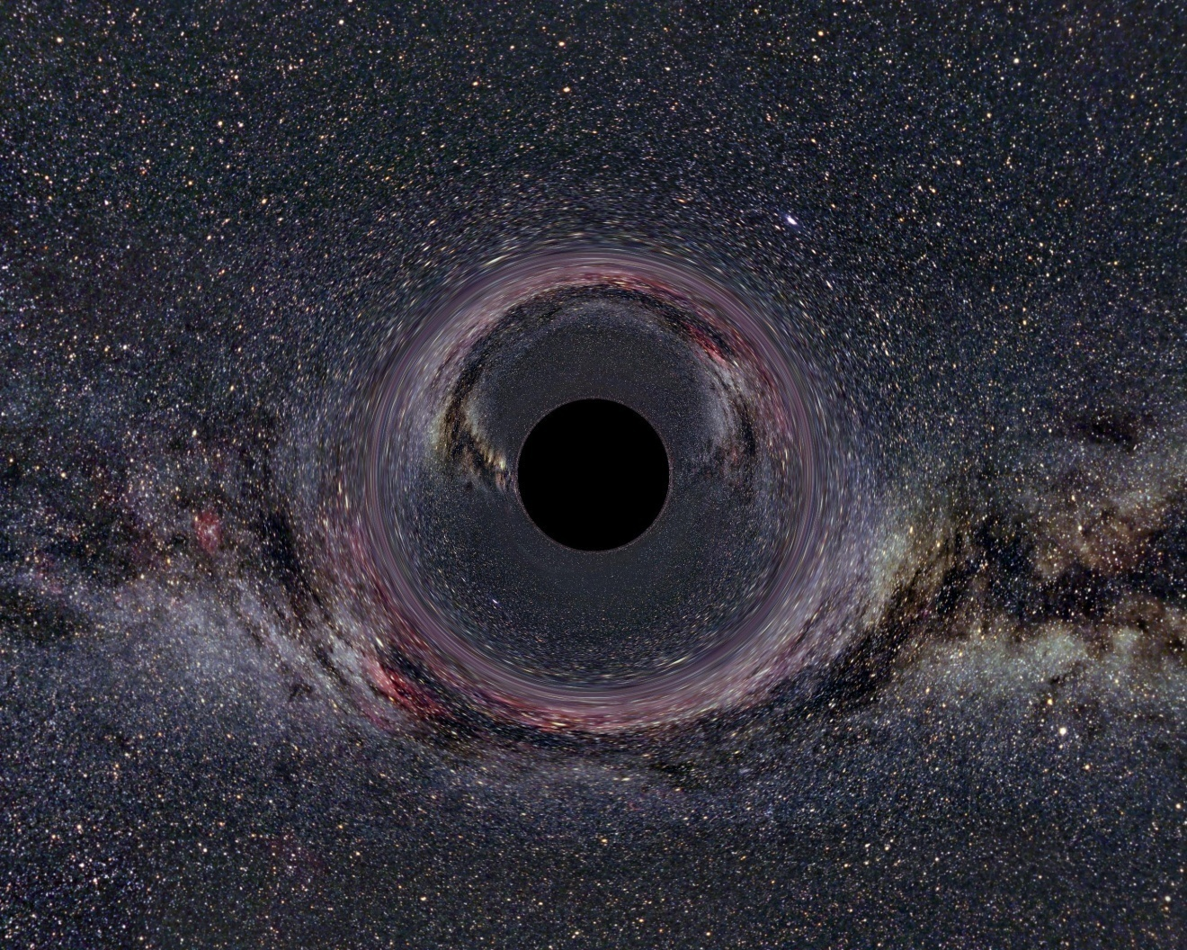
Differential Manifolds and Tensors
taken from wikipedia.org
A presentation of the topic as in:
B. F. Schutz,
Geometrical methods of mathematical Physics, chap. 2

Slide 2
basic analytic tools
What are they?

Slide 3









Metric spaces
A set with a metric function (denoted ) is defined to be a metric space if and only if:
  ,
  ,
  ,
  ,

Slide 4









Regions defined in a metric space
and , is defined to be a ball in if and only if: .
is defined to be open in if and only if: , : .

Slide 5




Regions defined in a metric space
Open sets satisfy the following properties:
  and are open sets
  family of open sets, is open
  finite family of open sets,

Slide 6









Topological spaces
A set with a collection of subsets (denoted ) is defined to be a topological space if and only if:
  and
  :
  :
is the set of all neighborhoods of in topology .

Slide 7






Mappings
A mapping is said to be a homeomorphism if and only if is continuous, that is, and : .
A mapping is said to be an isomorphism if and only if is a one-to-one and onto homeomorphism.
Diffeomorphisms require the definition of exterior geometry on and .

Slide 8
Differentiable manifolds
So… what are they!

Slide 9









Manifolds
A manifold is a topological space with topology for which, : , and which is an isomorphism to an open subset of .
The pair is called a chart.

Slide 10









Differentiable manifolds
Consider 2 overlapping charts and on a manifold . and are said to be -related if with and , is -differentiable.

Slide 11

Differentiable manifolds
An atlas is a collection of charts, whose regions cover all of the manifold .
If every chart in the atlas is -related to every other it overlaps with, is said to be a -manifold.
From now on, we will suppose for the sake of comfort or analytic manifolds!

Slide 12






Diffeomorphisms
Any mapping between -manifolds and of the same dimension , is said to be a diffeomorphism of onto if, is 1-1 and -differentiable (locally!).

Slide 13
working on differentiable manifolds
About time!

Slide 14



Curves in manifolds
A curve is the image of an open interval of through the differentiable mapping:
(
)
λ

Slide 15





Functions on manifolds
Henceforth charts will be denoted as with implied locality.
So, let . By we refer to the locally defined , where .

Slide 16


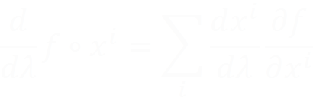

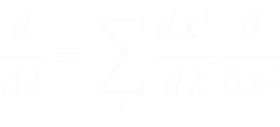
Tangent vectors
Consider a curve and a function locally on a manifold . Then on a point :
, so that:

Slide 17


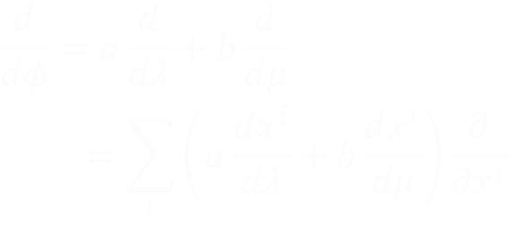
Tangent vectors
There is a unique tangent vector on for every passing curve with proper parameter, having coordinates on a basis .
Tangent vectors combine linearly to a new:

Slide 18

Tangent space
is the space of derivatives (TV) of all passing curves at .
is a vector space.
For distinct points , are distinct as well.
is a basis on , but an new basis can be defined which is not necessarily a coordinate basis.
Fiber Bundles and transition on ?

Slide 19


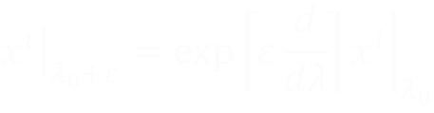
Vector fields and Integral curves
Gives a vector in , , denoted as .
Integral curves are all curves tangent to vector fields.
The set of the manifold-filling Integral curves is called a congruence.
Local (not infinitesimal) extrapolation by :

Slide 20
tensors
Now were talking!

Slide 21










One-forms
One-forms
Vectors
takes a vector as an argument and returns a real number, .
duality brackets
lies on the dual of the tangent space at , .
Also known: covariants!
Dual base .
dual base definition
takes a one-form as an argument and returns a real number, .
lies on the tangent space at , .
Also known: contravariants!
Base .

Slide 22




Tensors
takes one-forms (left) and vectors (right) as arguments and gives a real number.
Denoted:
where, is the # of covariant arguments and is the number of contravariant arguments.

Slide 23









Tensor or
One-forms
Vectors
For fixed , is a one-form!
is a tensor
One-forms are tensors of the type:
contraction
is a scalar
For fixed , is a vector!
Vectors are tensors of the type:

Slide 24
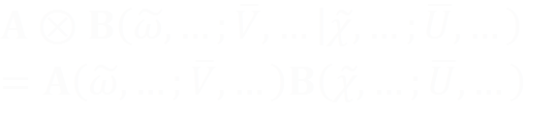



Tensor product
Inductive definition with obvious initialization:
Under bases and their duals , have components:
Tensors are susceptible to transformations as their component bases are.

Slide 25
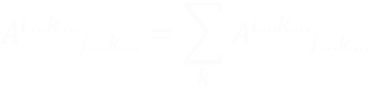
Contraction
General representation is non-trivial! Sorry.
Contraction is independent of basis though!
It materializes on components by eliminating pairs of co- and contra- variant indices:
That looks like Einstein’s Notation… yielded in a rather natural way based on vector duality!

Slide 26
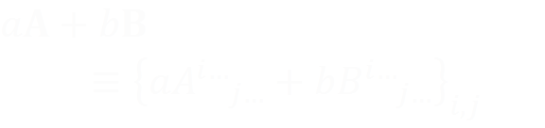

Tensor oprerations on components
Tensors form Vector spaces:
Multiplication of components:
Contraction of pair of indices one of which is up and the other down…!

Slide 27
applications
What are you taliking about?

Slide 28



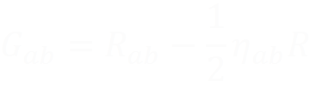

Space-Tme
One defines a special tensor called the metric tensor .
From the curvuture tensor , we obtain by contraction the trace-reversed Ricci tensor also known as Einstein’s Tensor:
Stress-energy tensor is defined explicitly!

Slide 29
References
B. F. Schutz,
Geometrical Methods of Mathematical Physics,
(Cambridge University Press)
Kip S. Thorne, Gravitational Waves, Caltech's Physics 237-2002. [http://elmer.tapir.caltech.edu/ph237/CourseMaterials.html]
and some e-scrolling of course…:

Slide 30
That’s All Folks!

